Slide 1


Paper ID:1610 Paper Title: WEB ENABLED FINGERPRINT BASED ELECTRONIC VOTING MACHINE FOR PRIVATE COMMUNITIES
International Conference on Artificial Intelligence and Sustainable Innovation 2025 (ICAISI-2025)
Presented By:
Brijesh Nishad
Ashutosh
Aayush Pandey

Slide 2
Outline
Introduction
Related Work
Proposed Methodology
Experiments and Results
Conclusion and Future Scope

Slide 3
Introduction
Voting is crucial for democratic processes even in small communities
Traditional voting methods are prone to fraud and inefficiencies
Lack of automation leads to time delays and human errors
Biometric systems help verify identity with high accuracy
Web-based systems improve transparency and result access
Integration of both enhances trust and efficiency in elections

Slide 4
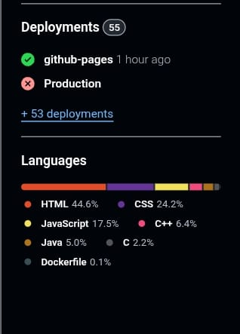
Related Work
Traditional paper and EVMs lack biometric verification
Some systems use biometrics but are not web-enabled
Online voting platforms often lack secure ID verification
Existing systems suffer from data security issues
Limited use in private, local community settings
High cost and complexity limit adoption

Slide 5
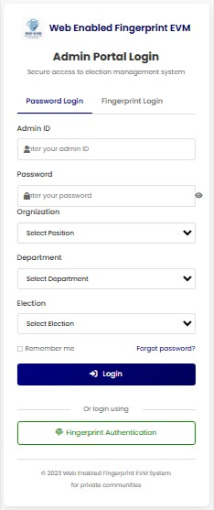
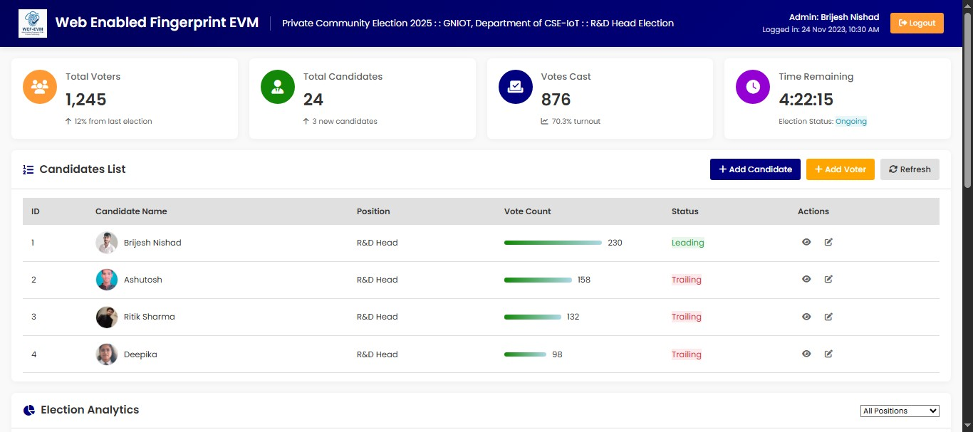
Proposed Methodology
Dashboard
Admin Portal Login

Slide 6
Experiments and Results
Voting Prototype: Built using Arduino/ESP32 with integrated biometric and connectivity modules.
Test Scenarios:
Valid and invalid fingerprint input
Multiple voting attempts
Real-time web result updates
Wi-Fi disconnection and reconnection
Admin result access from remote device

Slide 7
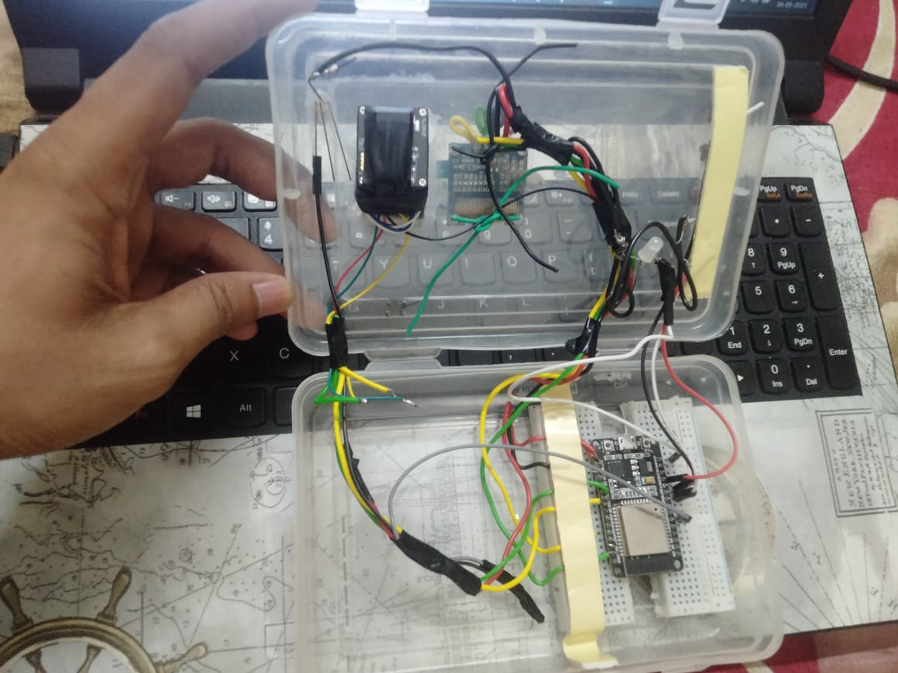
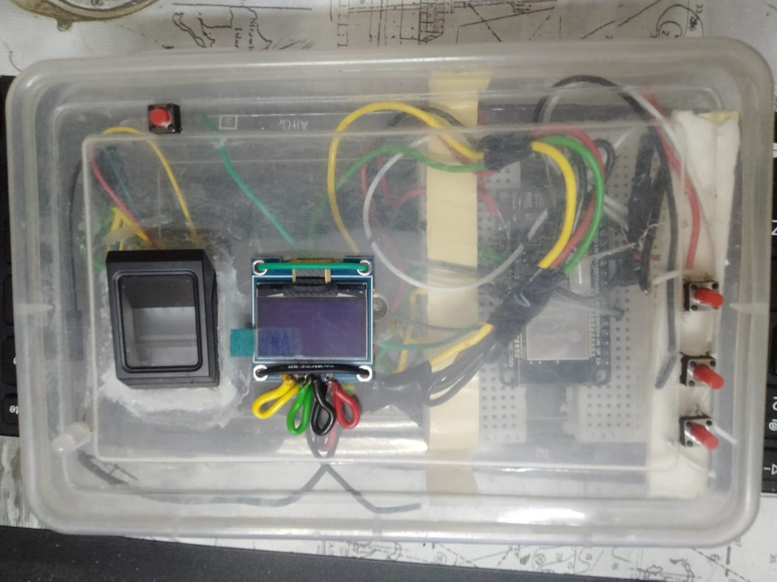
Experiments and Results
Hardware interfacing

Slide 8
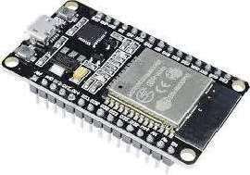
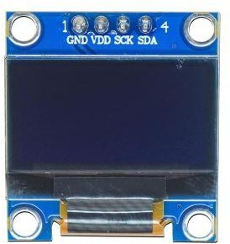
Experiments and Results
Hardware Components
ESP32 OLED Module
Built-in Wi-Fi
Low Cost
Open source
Community and Library Support
Alphanumeric Display 16x2 Format
Parallel Communication Low Power Consumption

Slide 9
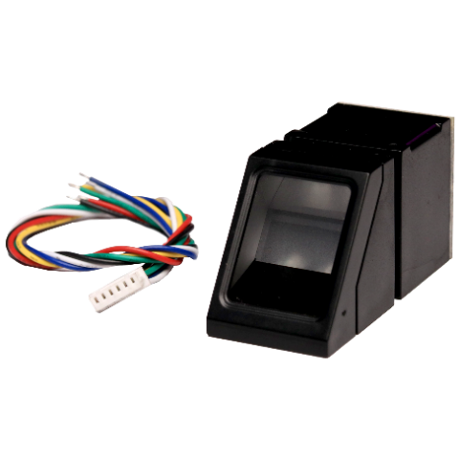

Experiments and Results
Fingerprint Scanner
LED
Finger print scanner
Collection of Data
High Sensitivity
Low Cost
Shows system power/status
Indicates successful fingerprint scan
Alerts for invalid votes
Blinks during vote casting
Green = Success, Red = Error

Slide 10
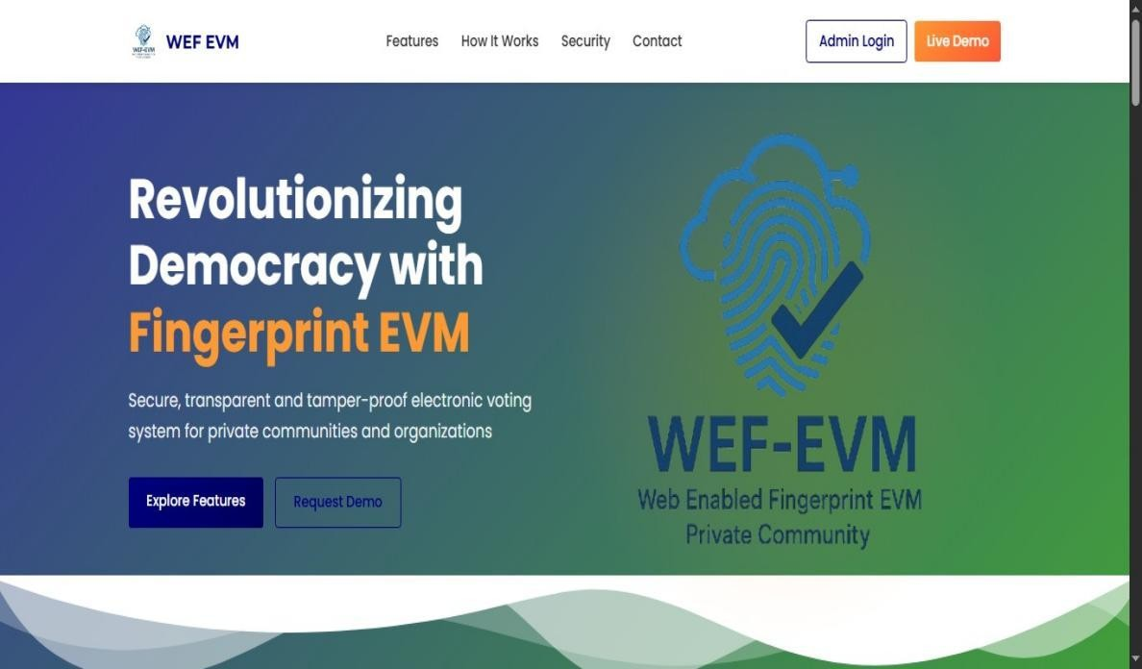
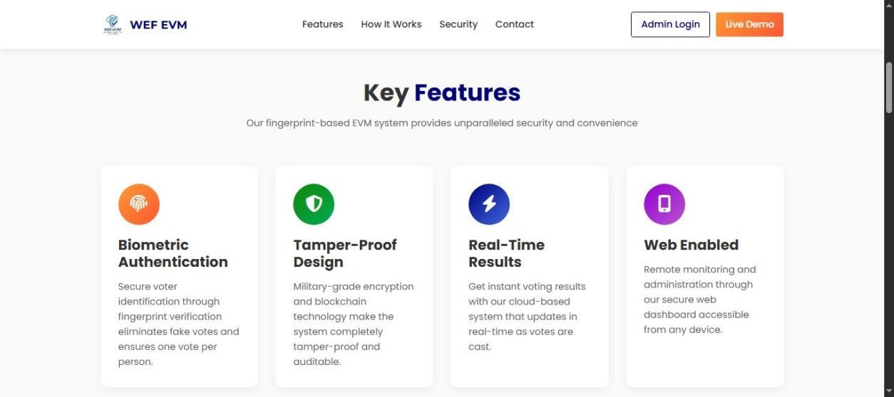
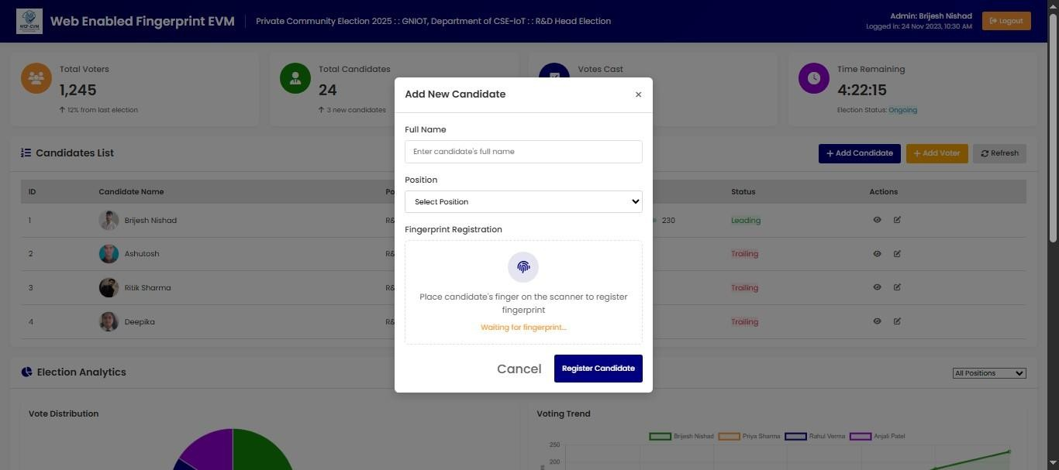
Experiments and Results
` Software Components
Admin Home Page 1 Features Home Page 2 Add New Candidate

Slide 11
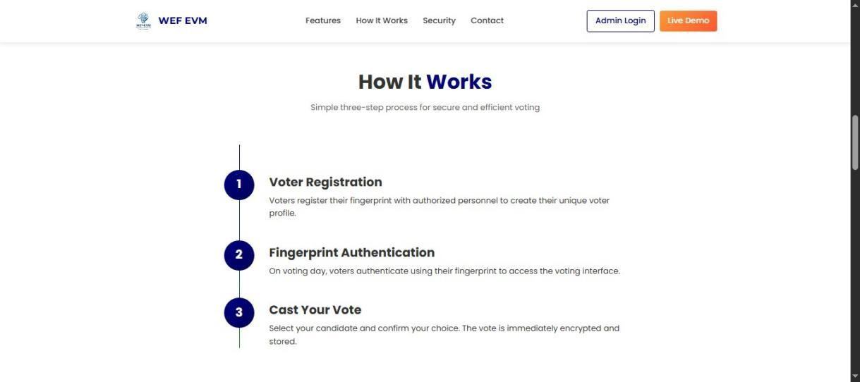
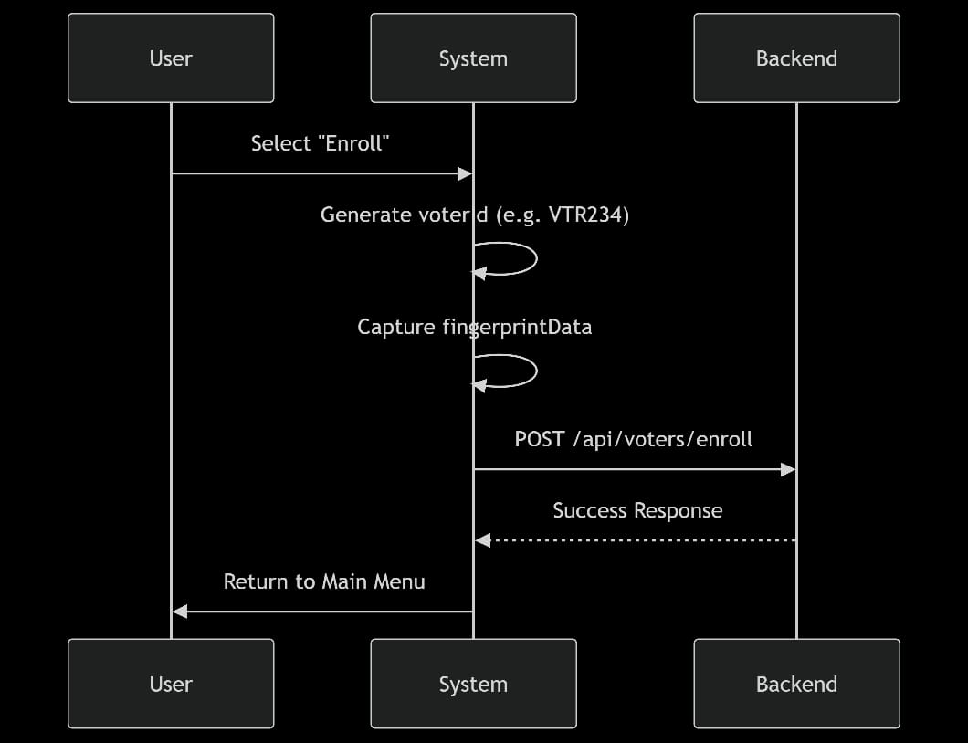
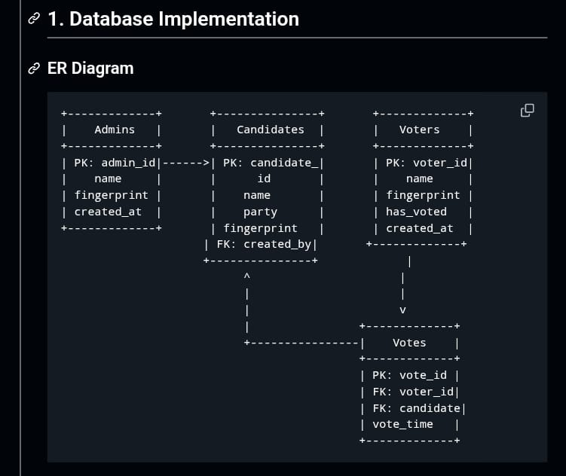
Experiments and Results
Working Process

Slide 12
Conclusion and Future Scope
The web-enabled fingerprint voting system improves election security through real-time voter authentication.
Accurately verifies voter identity, preventing unauthorized or duplicate votes.
Provides fast, local alerts (LED/buzzer) and remote notifications via the web dashboard for administrators.
Future deployment in real private communities will validate practical effectiveness and user acceptance.

Slide 13
Thankyou

